Slide 1

Introduction to Software Business Product management
Week 2 Day 2
Led by: Emily Crose
for
Oakland University

Slide 2

Week 1 recap

Slide 3

Questions From Last Week?

Slide 4

Operating systems overview

Slide 5
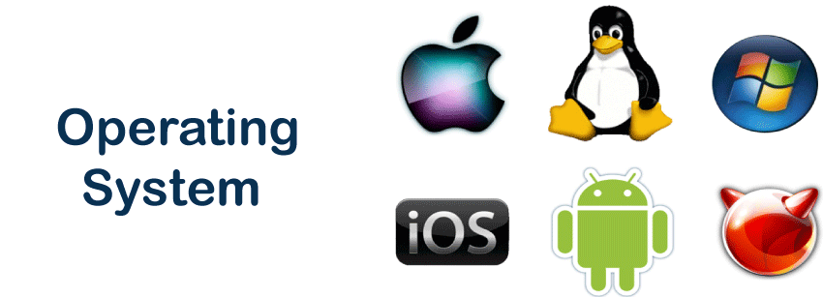
Operating systems

Slide 6
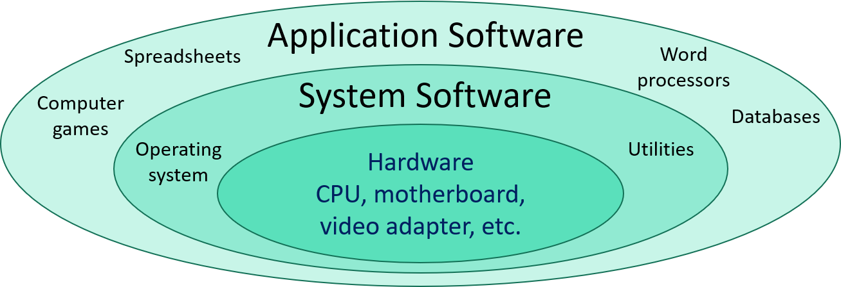
Operating Systems vs Applications
Notes:
What about you all? Where do you come from? What kinds of backgrounds do you have?

Slide 7
Kernel

Slide 8
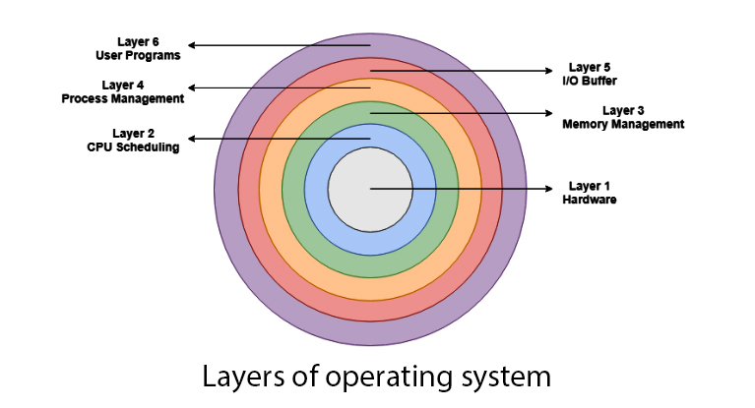

Slide 9
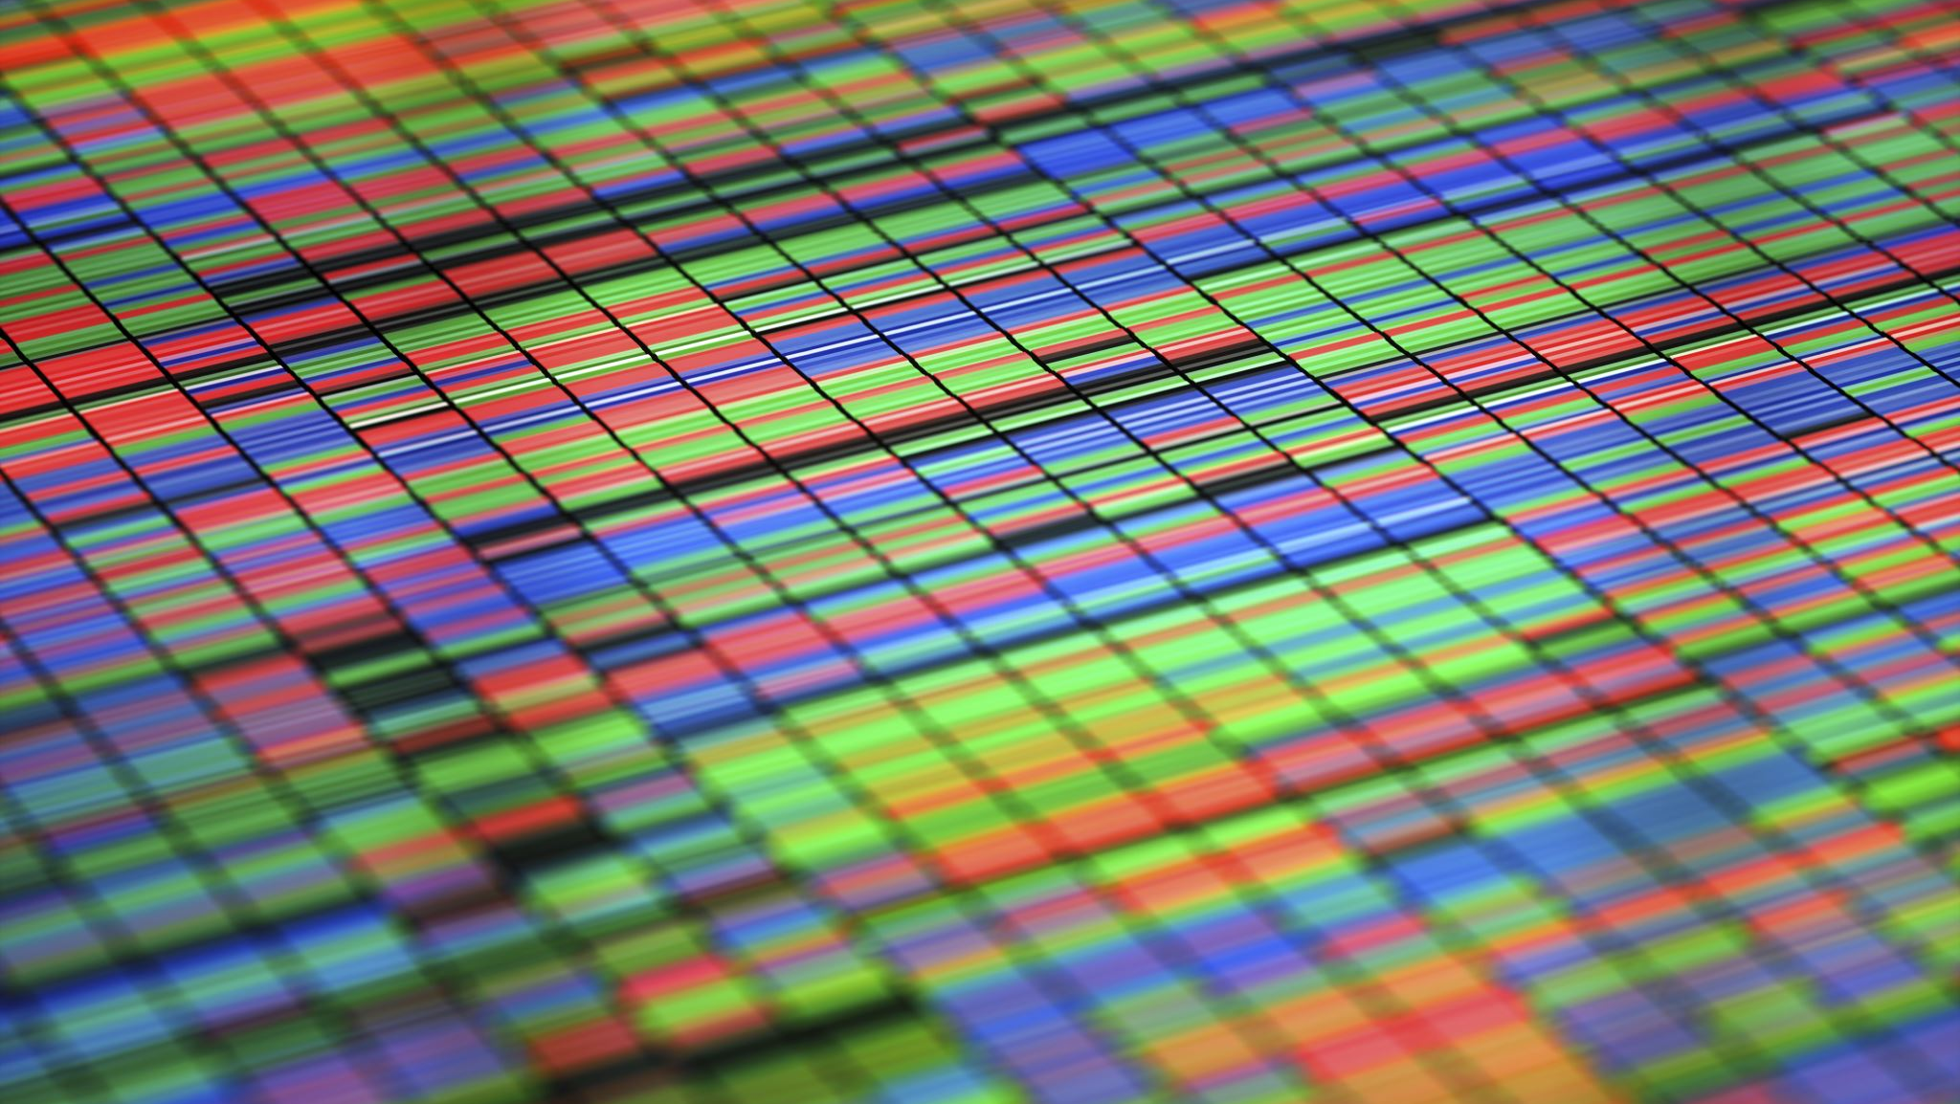
Applications

Slide 10
Application & Computing History

Slide 11
Types of Applications
Mobile applications
Desktop applications
Embedded applications
Web applications

Slide 12
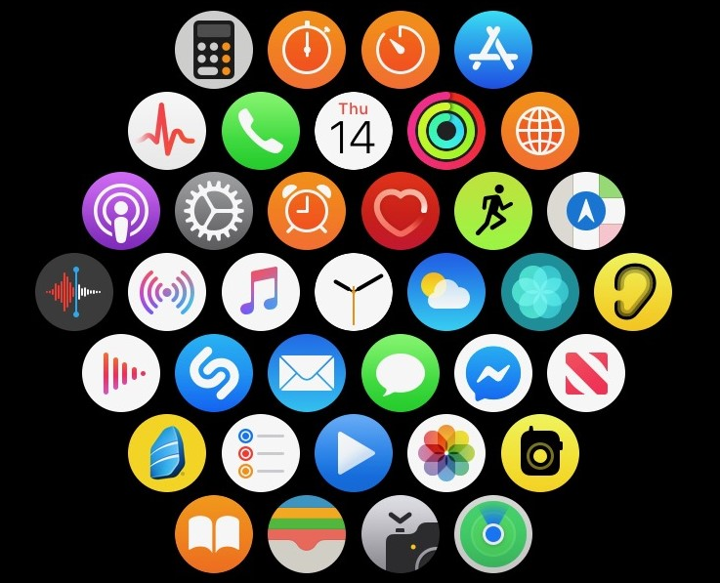
Mobile Applications

Slide 13
Desktop Applications

Slide 14
Embedded Applications

Slide 15
Web Applications

Slide 16
“thin” client vs “thick” client
Notes:
There are also applications that serve to give access to

Slide 17
CPU Architecture

Slide 18
Data security & Encryption

Slide 19
Application Programming Interfaces (APIs)
What do they do for applications?
How do they work?

Slide 20
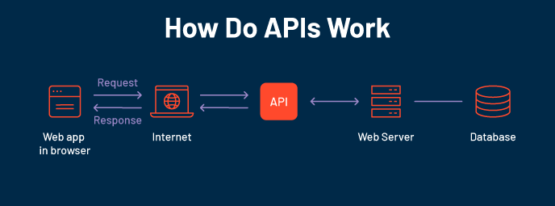

Slide 21
The software development life cycle
Notes:
Over the last couple of days, we’ve talked a lot about the types of software we may interact with in our lives. We now have a sense of scale of how large of a project it is to build an app, so the question for us becomes; how do we approach this project with as much organization as possible? That’s where the software development life cycle comes into play

Slide 22
What is the Software Development Life Cycle?
The SDLC helps us organize the process of building software
Includes steps for building, revising, and deploying software
Includes roles associated with each step along the building process

Slide 23
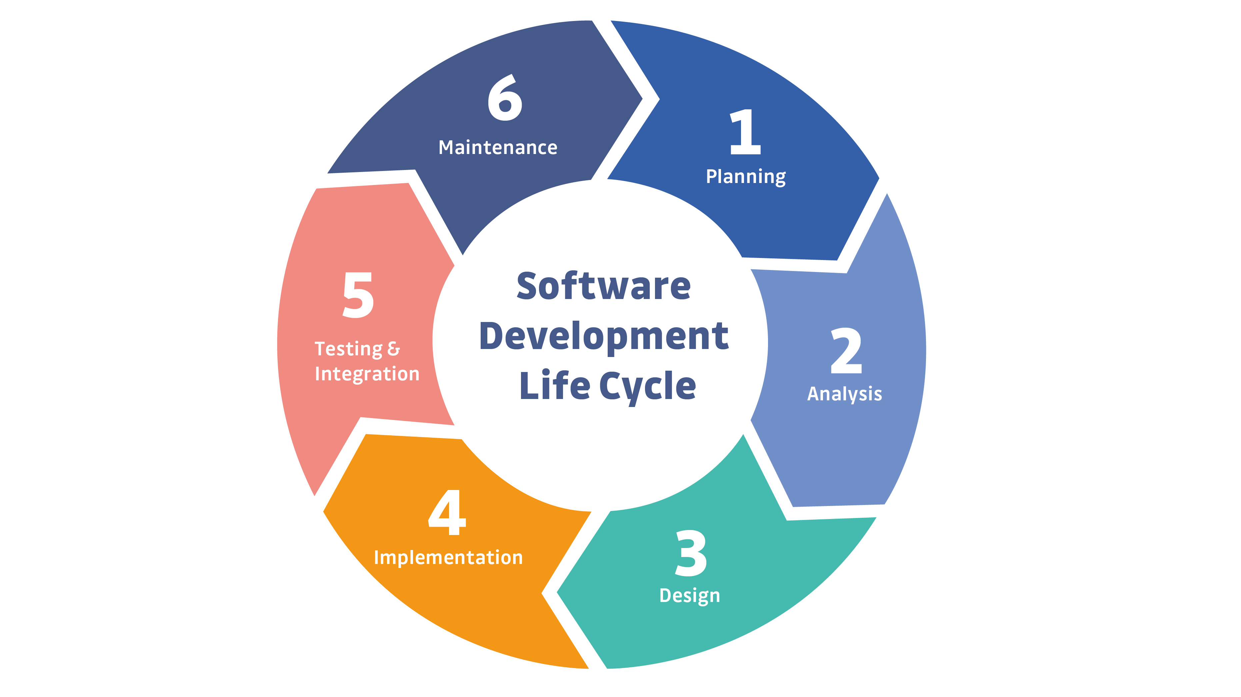
Notes:
This is a simple example of the SDLC. Typically, representations of the SDLC will have around 6 steps, but the steps will generally match what you see here.

Slide 24

Question or clarifications?

Slide 25

Questions?

Slide 26

Review Day 2

Slide 27

Preview day 3

